Slide 1
NoSQL unit-2
Dr. SELVA KUMAR S
B.M.S COLLEGE OF ENGINEERING

Slide 2
AGENDA
NOSQL Storage Architecture
Performing CRUD operations
Querying NoSQL stores
Modifying and Managing NOSQL Data stores
Indexing and ordering datasets

Slide 3
Understanding the Storage Architecture
Column-oriented databases are among the most popular types of non-relational databases.
Publication from Google on big table established beyond a doubt that a cluster of inexpensive hardware can be leveraged to hold huge amounts data, way more than a single machine can hold, and be processed effectively and efficiently within a reasonable timeframe.
Three key themes emerged:
1. Data needs to be stored in a networked filesystem that can expand to multiple machines.
2. Data needs to be stored in a structure that provides more flexibility than the traditional normalized relational database structures.
The storage scheme needs to allow for effective storage of huge amounts of sparse data sets. It needs to accommodate for changing schemas without the necessity of altering the underlying tables.
3. Data needs to be processed in a way that computations on it can be performed in isolated subsets of the data and then combined to generate the desired output.
Notes:
https://dataschool.com/data-modeling-101/row-vs-column-oriented-databases/#:~:text=Column%20oriented%20databases%20are%20databases,and%20computing%20on%20columns%20efficiently.

Slide 4
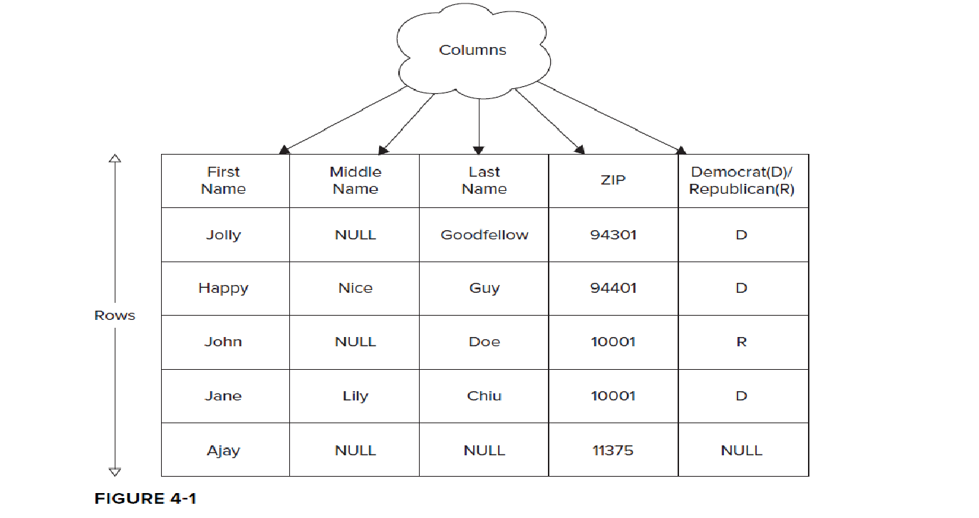
WORKING WITH COLUMN-ORIENTED DATABASES
Using Tables and Columns in Relational Databases

Slide 5
1)RDBMS table has a few columns, sometimes tens of them-> Millions of rows could potentially be held in a relational table 🡪 may bring the data access to a halt, unless special considerations like denormalization are applied.
2) As you begin to use your table 🡪 may need to alter it to hold a few additional attributes
As newer records are stored 🡪 may have null values for these attributes 🡪 the existing records.
3)Keeping greater variety of attributes the likelihood of sparse data sets 🡪 sets with null in many cells 🡪 becomes increasingly real.

Slide 6
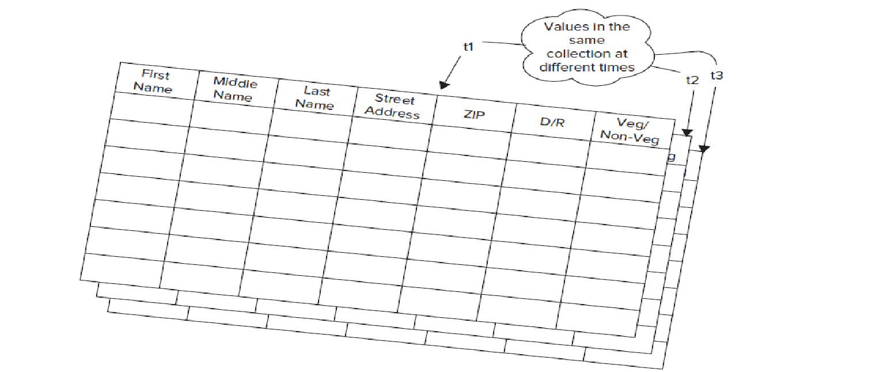
Consider that this data is evolving and you have to store each version of the cell value as it evolves.
Think of it like a three-dimensional Excel spreadsheet, where the third dimension is time.
Then the values as they evolve through time could be thought of as cell values in multiple spreadsheets put one behind the other in chronological order
Therefore
Altering the table as data evolves,
storing a lot of sparse cells,
and
working through value versions can get complex

Slide 7
Contrasting Column Databases with RDBMS
First and foremost, a column-oriented database imposes minimal need for upfront schema definition and can easily accommodate newer columns as the data evolves.
In a typical column-oriented store, you predefine a column-family and not a column.
A column-family is a set of columns grouped together into a bundle.
In a column database, a column-family is analogous to a column in an RDBMS.
Both are typically defined before data is stored in tables and are fairly static in nature.
Columns in RDBMS define the type of data they can store.
Column-families have no such limitation; they can contain any number of columns, which can store any type of data, as far as they can be persisted as an array of bytes.

Slide 8
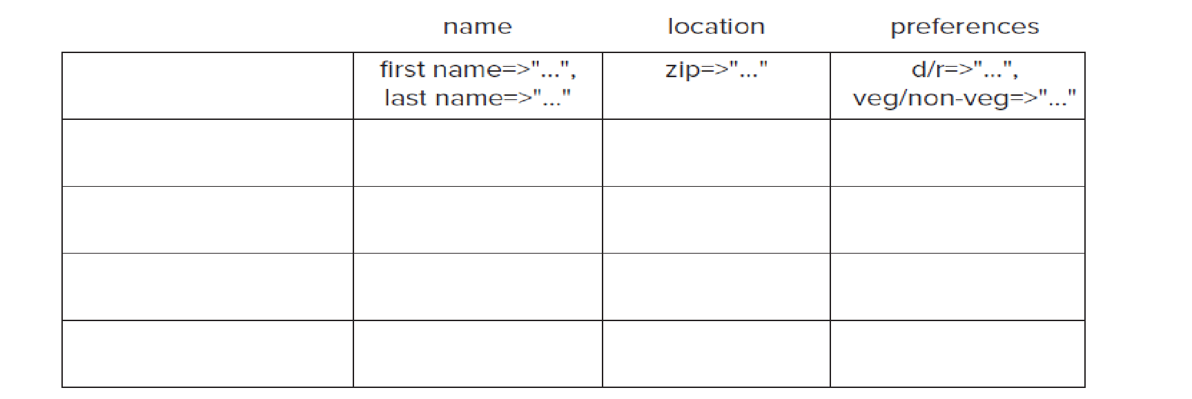
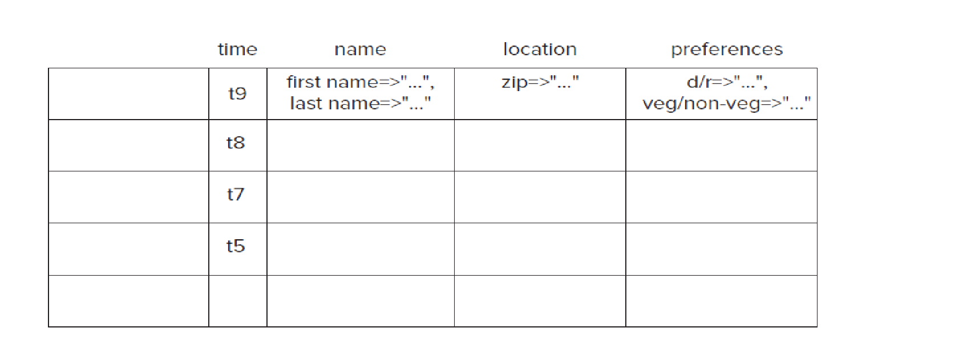
Each row of a column-oriented database table stores data values in only those columns for which it has valid values.
Continuously evolving data would get stored in a column database as shown in Figure

Slide 9
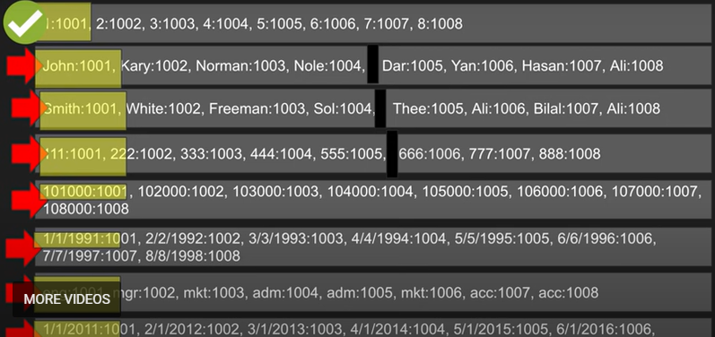
Example
Select * from emp where id=1

Slide 10
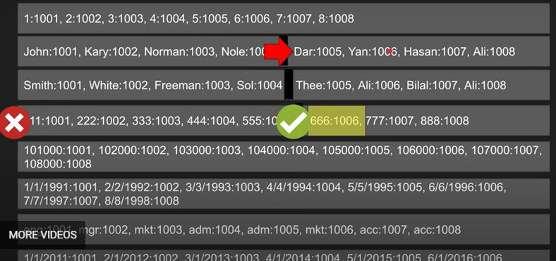
example
Select first_name from emp where ssn=666

Slide 11
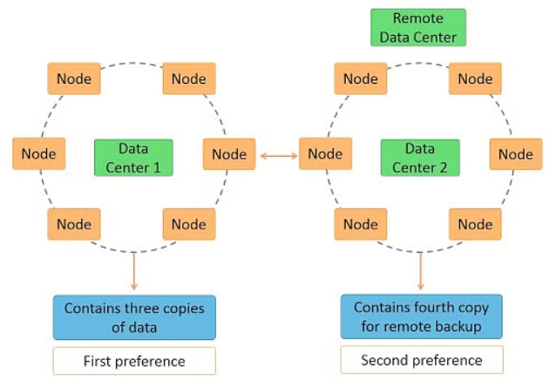
Cassandra architecture
Notes:
https://www.simplilearn.com/tutorials/big-data-tutorial/cassandra-architecture
Architecture Requirements of Cassandra
Cassandra was designed to address many architecture requirements. The most important requirement is to ensure there is no single point of failure. This means that if there are 100 nodes in a cluster and a node fails, the cluster should continue to operate.
This is in contrast to Hadoop where the namenode failure can cripple the entire system. Another requirement is to have massive scalability so that a cluster can hold hundreds or thousands of nodes. It should be possible to add a new node to the cluster without stopping the cluster.
Further, the architecture should be highly distributed so that both processing and data can be distributed. Also, high performance of read and write of data is expected so that the system can be used in real-time.

Slide 12
Cassandra architecture
Cassandra is designed such that it has no master or slave nodes.
It has a ring-type architecture, that is, its nodes are logically distributed like a ring.
Data is automatically distributed across all the nodes.
Data is replicated across the nodes for redundancy.
Data is kept in memory and lazily written to the disk.
Hash values of the keys are used to distribute the data among nodes in the cluster.

Slide 13
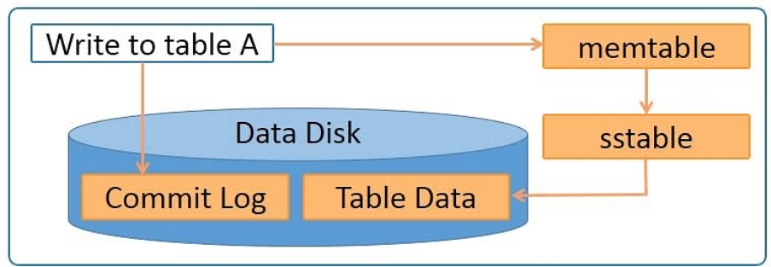
Cassandra write process

Slide 14
Cassandra write process
Data is written to a commitlog on disk.
The data is sent to a responsible node based on the hash value.
Nodes write data to an in-memory table called memtable.
From the memtable, data is written to an sstable in memory. Sstable stands for Sorted String table. This has a consolidated data of all the updates to the table.
From the sstable, data is updated to the actual table.
If the responsible node is down, data will be written to another node identified as tempnode. The tempnode will hold the data temporarily till the responsible node comes alive.

Slide 15
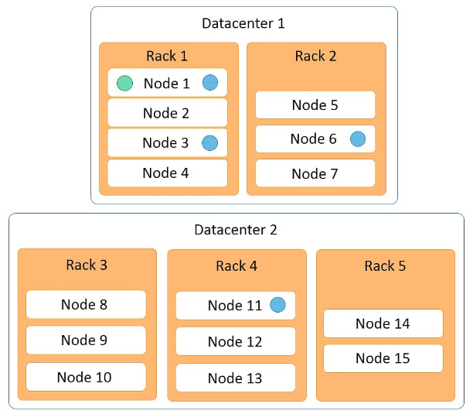
Cassandra read process
Notes:
The Cassandra read process ensures fast reads. Read happens across all nodes in parallel. If a node is down, data is read from the replica of the data. Priority for the replica is assigned on the basis of distance. Features of the Cassandra read process are:

Slide 16
Cassandra read process
Data on the same node is given first preference and is considered data local.
Data on the same rack is given second preference and is considered rack local.
Data on the same data center is given third preference and is considered data center local.
Data in a different data center is given the least preference.
Data in the memtable and sstable is checked first so that the data can be retrieved faster if it is already in memory.

Slide 17
Data partitions
Cassandra performs transparent distribution of data by horizontally partitioning the data in the following manner:
A hash value is calculated based on the primary key of the data.
The hash value of the key is mapped to a node in the cluster
The first copy of the data is stored on that node.
The distribution is transparent as you can both calculate the hash value and determine where a particular row will be stored.

Slide 18
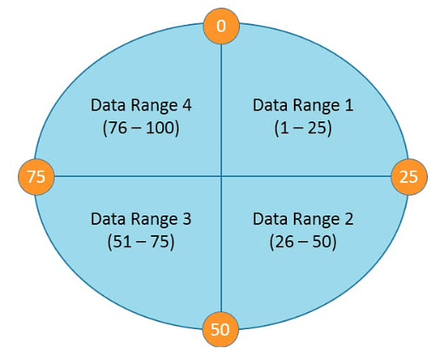
Data partitions
The following diagram depicts a four node cluster with token values of 0, 25, 50 and 75.
Notes:
For a given key, a hash value is generated in the range of 1 to 100. Keys with hash values in the range 1 to 25 are stored on the first node, 26 to 50 are stored on the second node, 51 to 75 are stored on the third node, and 76 to 100 are stored on the fourth node. Please note that actual tokens and hash values in Cassandra are 127-bit positive integers.

Slide 19
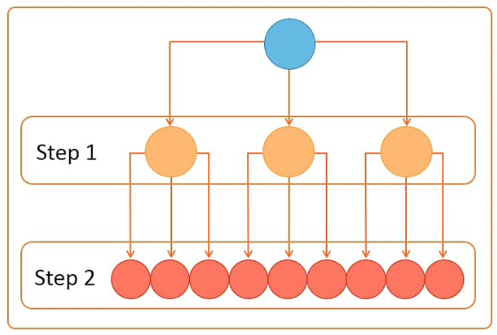
Gossip protocol
Cassandra uses a gossip protocol to communicate with nodes in a cluster.
It is an inter-node communication mechanism similar to the heartbeat protocol in Hadoop.
The gossip process runs periodically on each node and exchanges state information with three other nodes in the cluster.
Eventually, information is propagated
to all cluster nodes.
Notes:
In step 1, one node connects to three other nodes. In step 2, each of the three nodes connects to three other nodes, thus connecting to nine nodes in total in step 2. So a total of 13 nodes are connected in 2 steps.

Slide 20
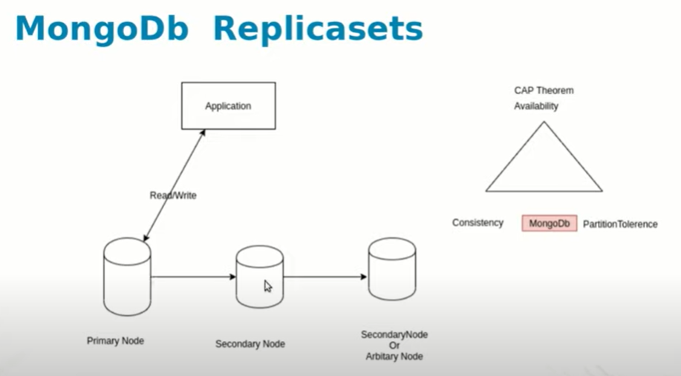
Mongodb architecture
Notes:
Replication serves as a very important feature in order to protect data loss from one server, increase the availability of data, and give protection from failures.
MongoDB achieves replication using the concept replica sets. A replica set is a group of mongod instances that host the same data set. One of the nodes is selected as the primary or main node. This is called the primary node. All others are called secondary nodes. The primary node receives all the operations from the user and the secondaries are updated from the primary one by using the same operation to maintain consistency. If the primary node goes down, one of the secondary nodes is selected as the primary node and the operations are carried forward. When the fallen node recovers, it joins the cluster as the secondary nodes. We can control our cluster of mongo instances using Mongo Atlas. Mongo clusters are created based on the idea of horizontal scaling and adding of instances.

Slide 21
Replication in mongodb
MongoDB achieves replication using the concept replica sets.
A replica set is a group of mongod instances that host the same data set.
One of the nodes is selected as the primary or main node.
The primary node receives all the operations from the user and the secondaries are updated from the primary one by using the same operation to maintain consistency.
If the primary node goes down, one of the secondary nodes is selected as the primary node and the operations are carried forward.
When the fallen node recovers, it joins the cluster as the secondary nodes.
We can control our cluster of mongo instances using Mongo Atlas.

Slide 22
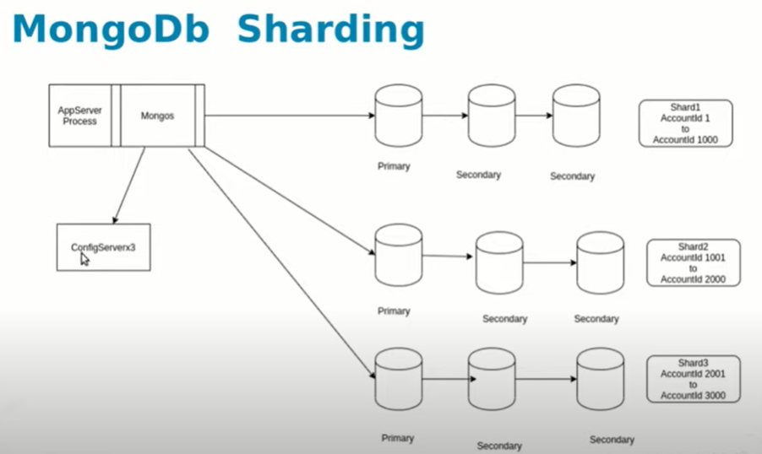
Notes:
Sharding arrangement in MongoDB has mainly three components:
Shards or replica sets: Each shard serves as a separate replica set. They store all the data. They target to increase the consistency and availability of the data.
Configuration Servers: They are like the managers of the clusters. These servers contain the cluster's metadata. They actually have the mapping of the cluster's data to the shards. When a query comes, query routers use these mappings from the config servers to target the required shard.
Query Router: The query router is mongo instances which serve as interfaces for user applications. They take in the user queries from the applications and serve the applications with the required results. Usually, there are multiple query router per cluster for load distribution.
A simple example of sharding occurs when a collection of user records is divided across a set of
servers, so that all the records for people with last names that begin with the letters A–G are on one
server, H–M are on another, and so on. The rule that splits the data is known as the sharding key
function, or the data hashing function.

Slide 23
Sharding in mongodb
Sharding is used by MongoDB to store data across multiple machines.
It uses horizontal scaling to add more machines to distribute data and operation with respect to the growth of load and demand.
Sharding arrangement in MongoDB has mainly three components:
1. Shards or replica sets
2. Configuration Servers
3. Query Router

Slide 24
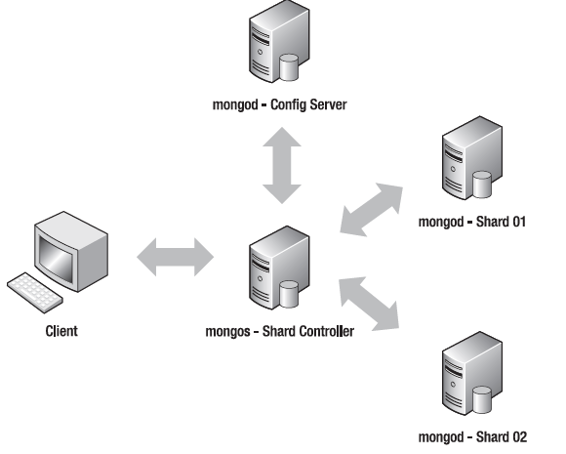
Simple sharding setup
Notes:
Manual Sharding and Automatic Sharding
Traditional sharding implementations require the application to be actively involved in
determining which server a particular document is stored on, so it can route its requests properly.
Traditionally, there is a library bound to the application, and this library is responsible for storing and
querying data in sharded data sets.
MongoDB uses a proxy mechanism to support sharding (see Figure 12–2); the provided mongos daemon
acts as a controller for multiple mongod-based shard servers. Your application attaches to the mongos
daemon as though it were a single MongoDB database server; thereafter, your application sends all of its
commands (e.g., updates, queries, and deletes) to that mongos daemon.
A sharding setup for MongoDB also needs a place to store the configuration of its shards, as well as a
place to store information about each shard server in the cluster. To support this, a MongoDB server
called a config server is required; this server instance is a normal mongod server running in a special role.
As explained above, the config servers also act as directories that allow the location of each chunk to be
determined

Slide 25
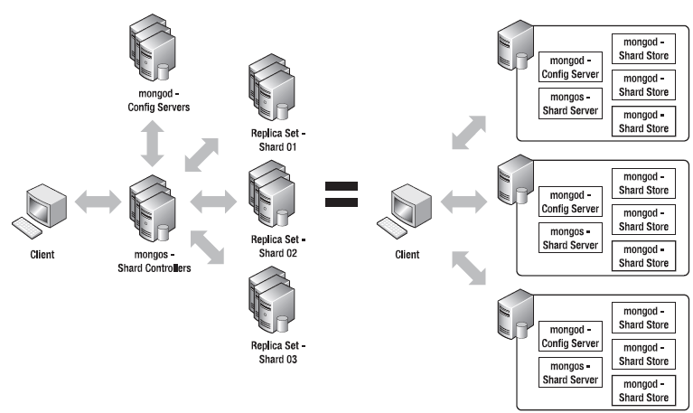
A redundant sharding configuration

Slide 26
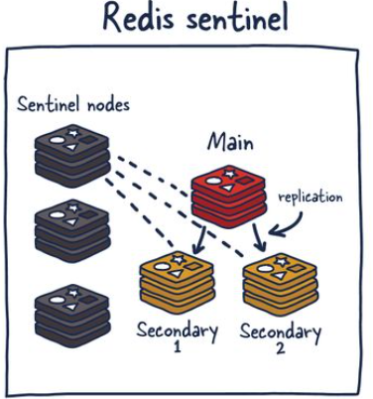
Redis architecture
Notes:
https://architecturenotes.co/redis/
Sentinel is a distributed system. As with all distributed systems, Sentinel comes with several advantages and disadvantages. Sentinel is designed in a way where there is a cluster of sentinel processes working together to coordinate state to provide high availability for Redis. Afterall you wouldn't want the system protecting you from failure to have its own single point of failure.
Sentinel is responsible for a few things. First, it ensures that the current main and secondary instances are functional and responding. This is necessary because sentinel (with other sentinel processes) can alert and act on situations where the main and/or secondary nodes are lost. Second, it serves a role in service discovery much like Zookeeper and Consul in other systems. So when a new client attempts to write something to Redis, Sentinel will tell the client what current main instance is.
So sentinels are constantly monitoring availability and sending out that information to clients so they are able to react to them if they indeed do failover.

Slide 27
Sentinels responsibilities
Monitoring — ensuring main and secondary instances are working as expected.
Notification — notify system admins about occurrences in the Redis instances.
Failover management — Sentinel nodes can start a failover process if the primary instance isn't available and enough (quorum of) nodes agree that is true.
Configuration management — Sentinel nodes also serve as a point of discovery of the current main Redis instance.
Notes:
Using Redis Sentinel in this way allows for failure detection. This detection involves multiple sentinel processes agreeing that current main instance is no longer available. This agreement process is called Quorum. This allows for increased robustness and protection against one machine misbehaving and being unable to reach the main Redis node.
Redis Cluster uses gossiping to determine the entire cluster's health. In the illustration above, we have 3 M nodes and 3 S nodes. All these nodes constantly communicate to know which shards are available and ready to serve requests. If enough shards agree that M1 isn't responsive, they can decide to promote M1's secondary S1 into a primary to keep the cluster healthy. The number of nodes needed to trigger this is configurable, and it is essential to get this right. If you do it improperly, you can end up in situations where the cluster is split if it cannot break the tie when both sides of a partition are equal. This phenomenon is called split brain. As a general rule, it is essential to have an odd number of primary nodes and two replicas each for the most robust setup.

Slide 28
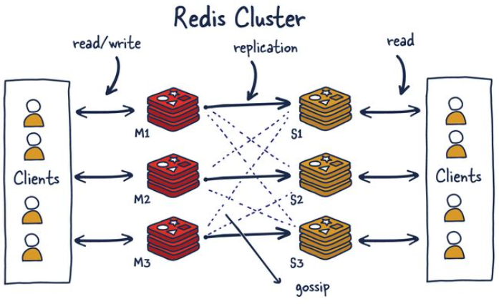

Slide 29
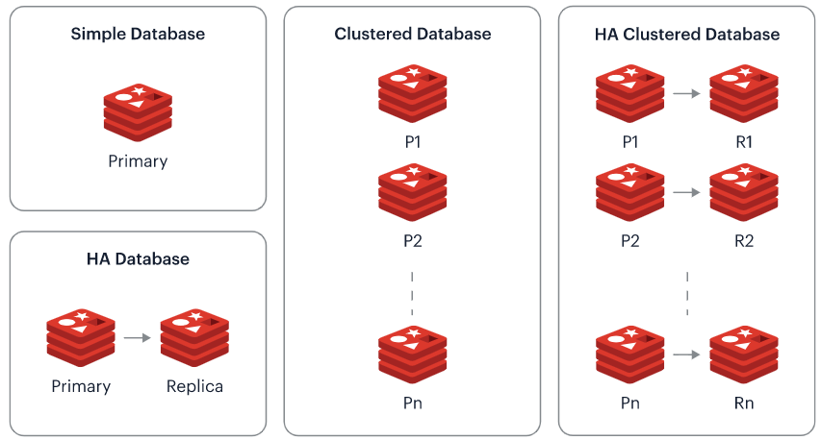
REDIS Enterprise cluster node
Notes:
High Availability : HA
https://redis.com/redis-enterprise/technology/redis-enterprise-cluster-architecture/

Slide 30
At any given time, a Redis Enterprise cluster node can include between zero and a few hundred Redis databases in one of the following types:
A simple database, i.e. a single primary shard
A highly available (HA) database, i.e. a pair of primary and replica shards
A clustered database, which contains multiple primary shards, each managing a subset of the dataset (or in Redis terms, a different range of “hash-slots”)
An HA clustered database, i.e. multiple pairs of primary/replica shards

Slide 31
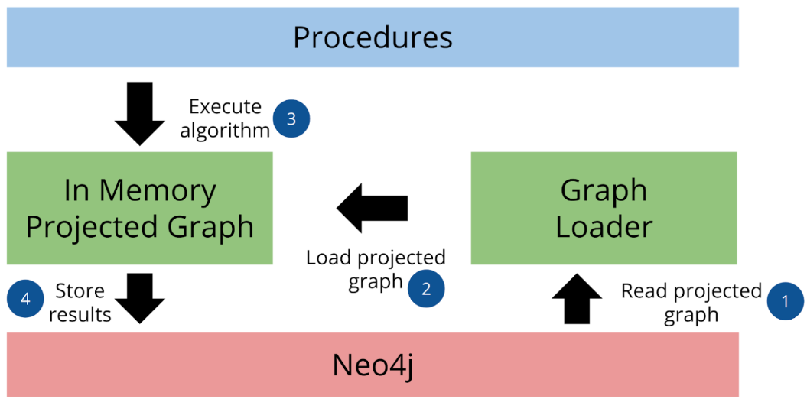
Neo4j architecture
Notes:
AuraDS makes it easy to run graph algorithms on Neo4j by integrating two main components:
Neo4j Database, where graph data are loaded and stored, and Cypher queries and all database operations (for example user management, query termination, etc.) are executed;
Graph Data Science, a software component installed in the Neo4j Database, whose main purpose is to run graph algorithms on in-memory projections of Neo4j Database data.
https://neo4j.com/docs/aura/aurads/architecture/

Slide 32
Graph data science
Reading the graph data from Neo4j Database
Loading (projecting) the data into an in-memory graph
Running an algorithm on a projected graph
Writing the results back to Neo4j Database (if the algorithm runs in write mode)

Slide 33
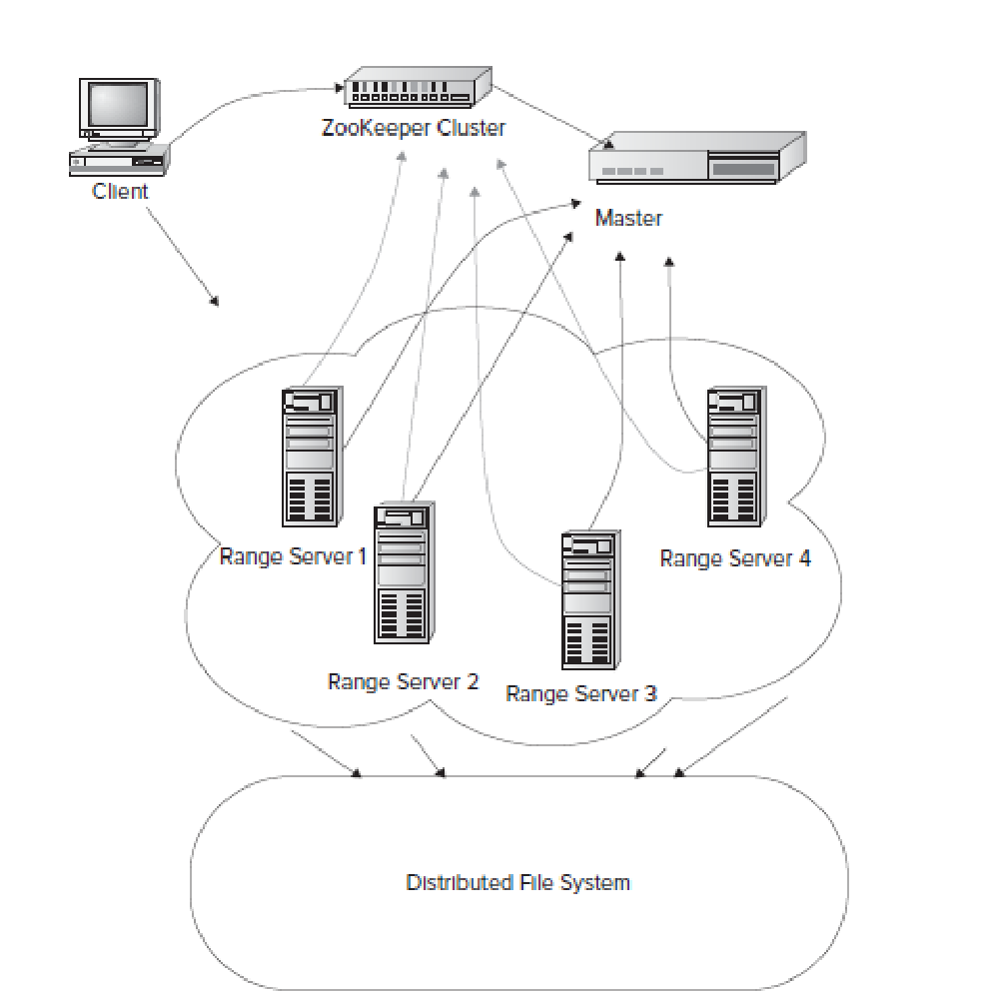
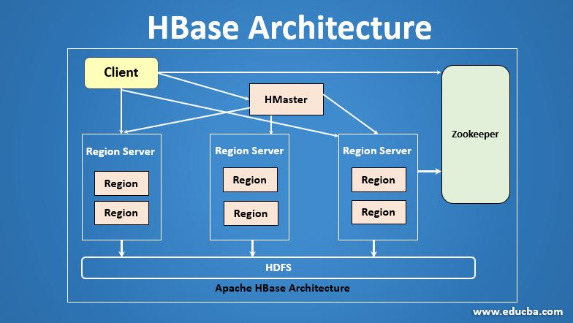
Hbase distributed storage architecture

Slide 34
Hbase?
HBase is a distributed column-oriented database built on top of the Hadoop file system.
It is an open-source project and is horizontally scalable.
HBase is a data model that is similar to Google’s big table designed to provide quick random access to huge amounts of structured data.
It leverages the fault tolerance provided by the Hadoop File System (HDFS).
It is a part of the Hadoop ecosystem that provides random real-time read/write access to data in the Hadoop File System.

Slide 35
HBase deployment adheres to a master-worker pattern.
Therefore, there is usually a master and a set of workers, commonly known as region servers.
When HBase starts, the master allocates a set of regions to a region server.
Each region stores an ordered set of rows, where each row is identified by a unique row-key.
As the number of rows stored in a region grows in size beyond a configured threshold, the region is split into two and rows are divided between the two new ranges.

Slide 36
HBase stores columns in a column-family together.
Therefore, each region maintains a separate store for each column-family
Each store in turn maps to a physical file that is stored in the underlying distributed filesystem.
For each store, HBase abstracts access to the underlying filesystem with the help of a thin wrapper that acts as the intermediary between the store and the underlying physical file.

Slide 37
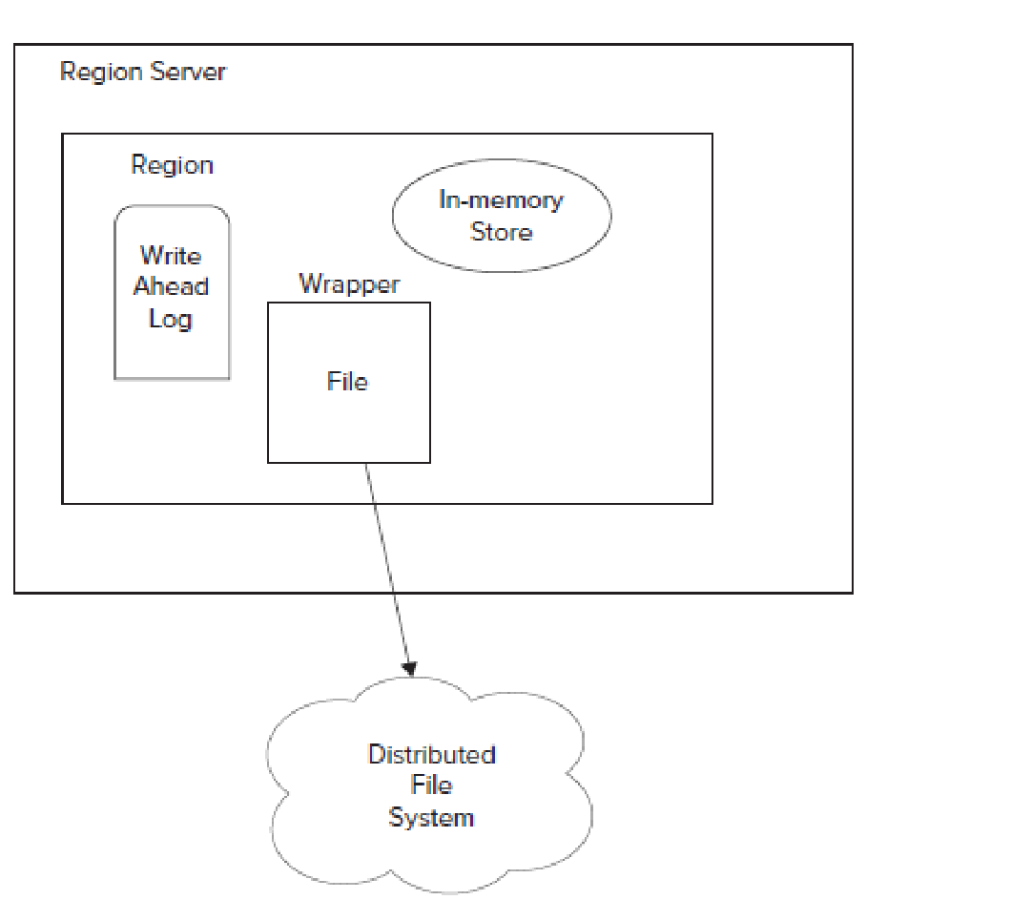
Each region has an in-memory store, or cache, and a write-ahead-log (WAL)
When data is written to a region, it’s first written to the write-ahead-log.
Soon afterwards, it’s written to the region’s in-memory store.
If thein-memory store is full, data is flushed to disk and persisted in the underlying distributed storage.

Slide 38
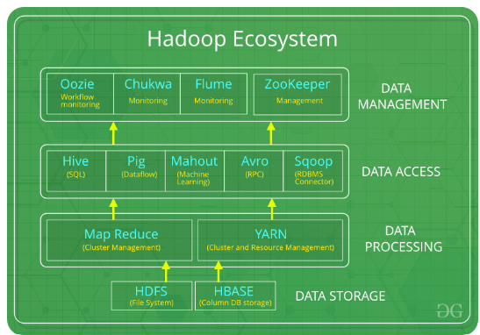
Notes:
https://www.youtube.com/watch?v=Mznogos4X00&list=PLKjwSP1bnrvMmokOfKIv49W50tQdM56Cn
HDFS: Hadoop Distributed File System
YARN: Yet Another Resource Negotiator
MapReduce: Programming based Data Processing
Spark: In-Memory data processing
PIG, HIVE: Query based processing of data services
HBase: NoSQL Database
Mahout, Spark MLLib: Machine Learning algorithm libraries
Solar, Lucene: Searching and Indexing
Zookeeper: Managing cluster
Oozie: Job Scheduling
HDFS is the primary or major component of Hadoop ecosystem and is responsible for storing large data sets of structured or unstructured data across various nodes and thereby maintaining the metadata in the form of log files.
Yet Another Resource Negotiator, as the name implies, YARN is the one who helps to manage the resources across the clusters. In short, it performs scheduling and resource allocation for the Hadoop System.
By making the use of distributed and parallel algorithms, MapReduce makes it possible to carry over the processing’s logic and helps to write applications which transform big data sets into a manageable one.
MapReduce makes the use of two functions i.e. Map() and Reduce() whose task is:
Map() performs sorting and filtering of data and thereby organizing them in the form of group. Map generates a key-value pair based result which is later on processed by the Reduce() method.
Reduce(), as the name suggests does the summarization by aggregating the mapped data. In simple, Reduce() takes the output generated by Map() as input and combines those tuples into smaller set of tuples.
Pig was basically developed by Yahoo which works on a pig Latin language, which is Query based language similar to SQL.
With the help of SQL methodology and interface, HIVE performs reading and writing of large data sets. However, its query language is called as HQL (Hive Query Language).
Mahout, allows Machine Learnability to a system or application. Machine Learning, as the name suggests helps the system to develop itself based on some patterns, user/environmental interaction or on the basis of algorithms.
Apache Spark:
It’s a platform that handles all the process consumptive tasks like batch processing, interactive or iterative real-time processing, graph conversions, and visualization, etc.
It consumes in memory resources hence, thus being faster than the prior in terms of optimization.
Spark is best suited for real-time data whereas Hadoop is best suited for structured data or batch processing, hence both are used in most of the companies interchangeably.
Apache HBase:
It’s a NoSQL database which supports all kinds of data and thus capable of handling anything of Hadoop Database. It provides capabilities of Google’s BigTable, thus able to work on Big Data sets effectively.
Solr, Lucene: These are the two services that perform the task of searching and indexing with the help of some java libraries, especially Lucene is based on Java which allows spell check mechanism, as well. However, Lucene is driven by Solr.
Zookeeper: There was a huge issue of management of coordination and synchronization among the resources or the components of Hadoop which resulted in inconsistency, often. Zookeeper overcame all the problems by performing synchronization, inter-component based communication, grouping, and maintenance.

Slide 39
Hadoop framework
Hadoop is a framework that enables processing of large data sets which reside in the form of clusters.
Hadoop is made up of several modules that are supported by a large ecosystem of technologies.
Hadoop Ecosystem is a platform or a suite which provides various services to solve the big data problems.
There are four major elements of Hadoop i.e. HDFS, MapReduce, YARN, and Hadoop Common.

Slide 40
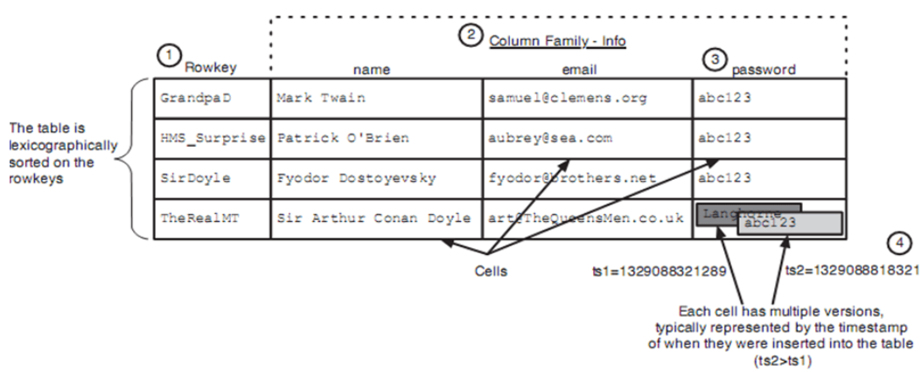
HBASE Data model
Notes:
Prerequisite JAVA and Hadoop installed on your system

Slide 41
How is HBase different from other NoSQL models
HBase stores data in the form of key/value pairs in a columnar model.
In this model, all the columns are grouped together as Column families.
HBase provides a flexible data model and low latency access to small amounts of data stored in large data sets.
HBase on top of Hadoop will increase the throughput and performance of distributed cluster set up.
In turn, it provides faster random reads and writes operations.

Slide 42
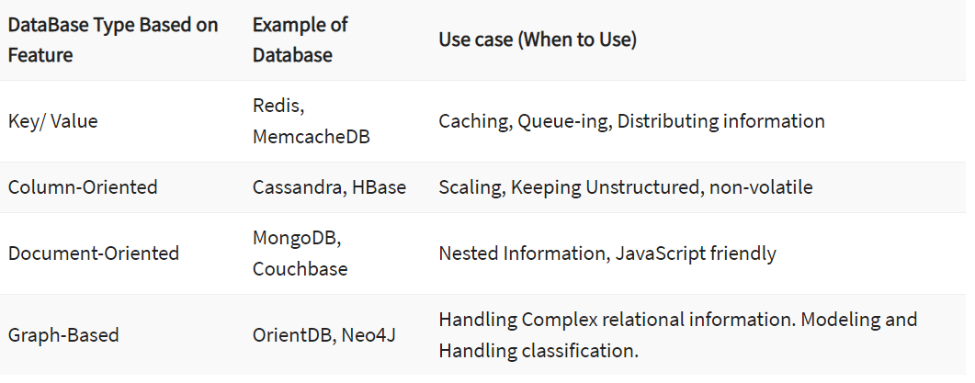
Use cases

Slide 43
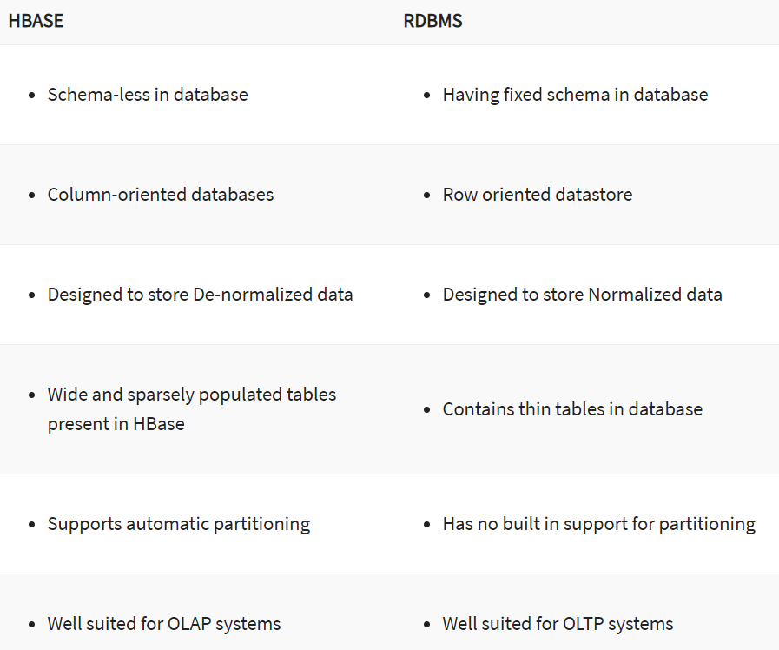
Hbase vs. rdbms

Slide 44
Hbase DDL commands
create - Creates a table.
list - Lists all the tables in HBase.
disable - Disables a table.
is_disabled - Verifies whether a table is disabled.
enable - Enables a table.
is_enabled - Verifies whether a table is enabled.
describe - Provides the description of a table.
alter - Alters a table.
exists - Verifies whether a table exists.
drop - Drops a table from HBase.
drop_all - Drops the tables matching the ‘regex’ given in the command.

Slide 45
Hbase dml commands
put - Puts a cell value at a specified column in a specified row in a particular table.
get - Fetches the contents of row or a cell.
delete - Deletes a cell value in a table.
deleteall - Deletes all the cells in a given row.
scan - Scans and returns the table data.
count - Counts and returns the number of rows in a table.
truncate - Disables, drops, and recreates a specified table.

Slide 46
example
hbase>create 'emp', 'personal data', 'professional data’
hbase>list
Table
emp
hbase>Scan ‘emp’
1 column = personal data:city, timestamp = 1417516501, value = hyderabad
1 column = personal data:name, timestamp = 1417525058, value = ramu
hbase>alter 'emp', NAME ⇒ 'personal data', VERSIONS ⇒ 5
hbase> alter ‘ table name ’, ‘delete’ ⇒ ‘ column family ’ // Deleting a column family

Slide 47
Example contd..
hbase> put 'selva', 'r1', 'c1', 'value, 10
hbase> put 'selva', 'r1', 'c1', 'value, 15
hbase> put 'selva', 'r1', 'c1', 'value, 20
hbase> get 'selva', 'r1', 'c1’
hbase> get 'selva', 'r1’
hbase>get 'selva', 'r1', {TIMERANGE => [ts1, ts2]}
hbase>get 'selva', 'r1', {COLUMN => ['c1', 'c2', 'c3’]}
hbase> delete 'selva', 'r1', 'c1'
hbase> deleteall 'selva', 'c1'

Slide 48
Indexing in MongoDB
MongoDB uses indexing in order to make the query processing more efficient.
If there is no indexing, then the MongoDB must scan every document in the collection and retrieve only those documents that match the query.
Indexes are special data structures that store a small part of the Collection’s data in a way that can be queried easily.
The indexes are order by the value of the field specified in the index.
In MongoDB, querying without indexes is called a collection scan. A collection scan will:
Result in various performance bottlenecks
Significantly slow down your application
Notes:
Indexes are special data structures that store a small part of the Collection’s data in a way that can be queried easily.
In simplest terms, indexes store the values of the indexed fields outside the table or collection and keep track of their location in the disk. These values are used to order the indexed fields. This ordering helps to perform equality matches and range-based query operations efficiently. In MongoDB, indexes are defined in the collection level and indexes on any field or subfield of the documents in a collection are supported.

Slide 49
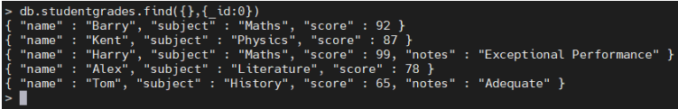
example
use students
db.createCollection("studentgrades")
db.studentgrades.insertMany(
[
{name: "Barry", subject: "Maths", score: 92},
{name: "Kent", subject: "Physics", score: 87},
{name: "Harry", subject: "Maths", score: 99, notes: "Exceptional Performance"},
{name: "Alex", subject: "Literature", score: 78},
{name: "Tom", subject: "History", score: 65, notes: "Adequate"}
]
)
db.studentgrades.find({},{_id:0})

Slide 50
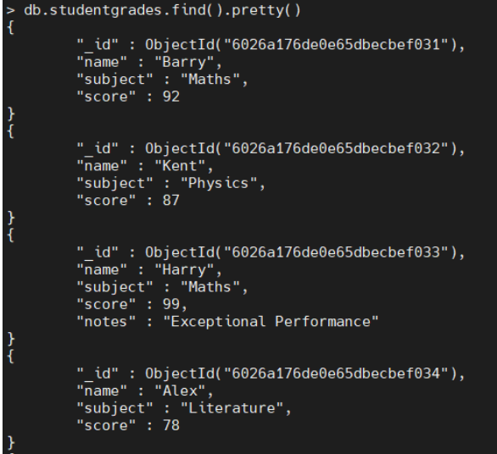
Default _id index
Notes:
When creating documents in a collection, MongoDB creates a unique index using the _id field. MongoDB refers to this as the Default _id Index. This default index cannot be dropped from the collection.
When querying the test data set, you can see the _id field which will be utilized as the default index:

Slide 51
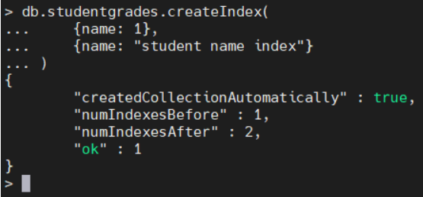
Create index method
db.<collection>.createIndex(<Key and Index Type>, <Options>)
When creating an index, you need to define the field to be indexed
The direction of the key (1 or -1) to indicate ascending or descending order.
db.studentgrades.createIndex(
{name: 1},
{name: "student name index"}
)

Slide 52
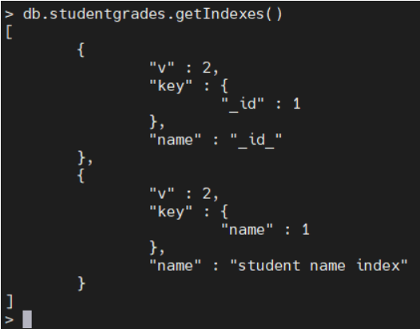
Get indexes method
db.<collection>.getIndexes()
db.studentgrades.getIndexes()
Notes:
The output contains the default _id index and the user-created index student name index.

Slide 53
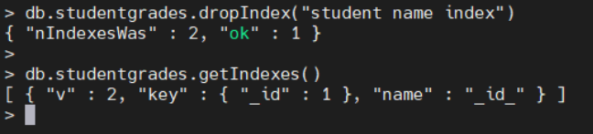
Drop index method
db.<collection>.dropIndex(<Index Name / Field Name>)
db.studentgrades.dropIndex("student name index")
db.studentgrades.dropIndexes()

Slide 54
Mongodb index types
Single field index
Compound index
Multikey index
Notes:
These user-defined indexes use a single field in a document to create an index in an ascending or descending sort order (1 or -1). In a single field index, the sort order of the index key does not have an impact because MongoDB can traverse the index in either direction.

Slide 55
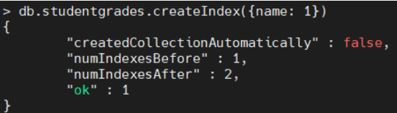
Single field index
db.studentgrades.createIndex({name: 1})

Slide 56
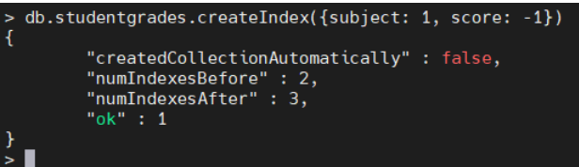
Compound index
db.studentgrades.createIndex({subject: 1, score: -1})
Notes:
In the above compound index, MongoDB will:
First sort by the subject field
Then, within each subject value, sort by grade

Slide 57
Multikey index
MongoDB supports indexing array fields.
These multikey indexes enable users to query documents using the elements within the array.
MongoDB will automatically create a multikey index when encountered with an array field without requiring the user to explicitly define the multikey type.
db.createCollection("studentperformance")
db.studentperformance.insertMany(
[
{name: "Barry", school: "ABC Academy", grades: [85, 75, 90, 99] },
{name: "Kent", school: "FX High School", grades: [74, 66, 45, 67]},
{name: "Alex", school: "XYZ High", grades: [80, 78, 71, 89]},
]
)
db.studentperformance.find({},{_id:0}).pretty()

Slide 58
Indexing in apache cassandra
Built-in indexes are the best option on a table which having many rows and that rows contain the indexed value.
In a particular column which column having more unique values in that case we can used indexing.
Table which more overhead due to several reason like column having more entries then in that case we can used indexing.
Notes:
https://www.youtube.com/watch?v=ABFZj9_BuOE
As we can access data using attributes which having the partition key. For Example, if Emp_id is a column name for Employee table and if it is partition key of that table then we can filter or search data with the help of partition key. In this case we can used WHERE clause to define condition over attribute and to search data. But suppose if there exists a column which is not a partition key of that table and we want to filter or to search or to access data using WHERE clause then the query will not be executed and will give an error.
So, to access data in that case using attributes other than the partition key for fast and efficient lookup of data matching a given condition then we need to define index. It can be used for various purpose like for collections, static columns, collection columns, and any other columns except counter columns.

Slide 59
Create index
Command ‘Create index’ creates an index on the column specified by the user.
After creating an index, Cassandra indexes new data automatically when data is inserted.
The index cannot be created on primary key as a primary key is already indexed.
Indexes on collections are not supported in Cassandra.
Without indexing on the column, Cassandra can’t filter that column unless it is a primary key.

Slide 60
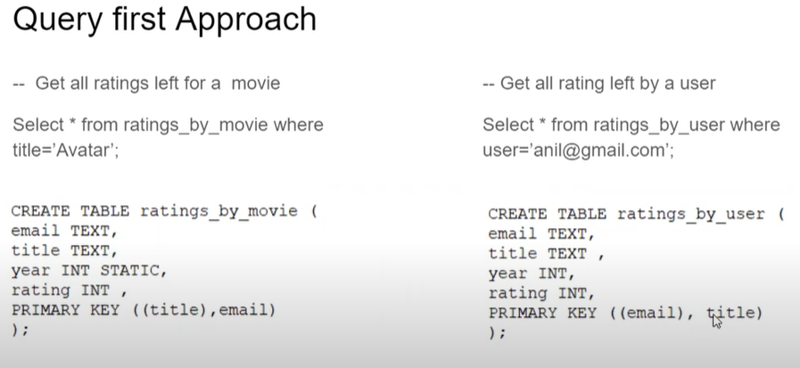
Notes:
Partition will be created based on the primary key
First query partition created based on title and email
Second query partition created based on email and title.

Slide 61
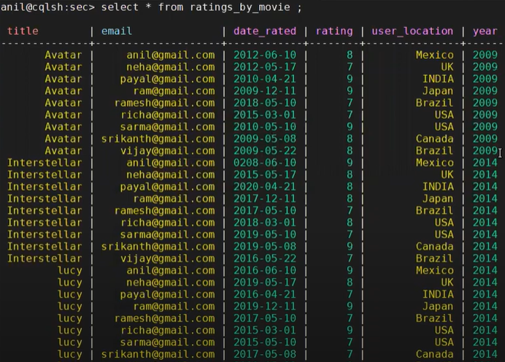
Query-1

Slide 62
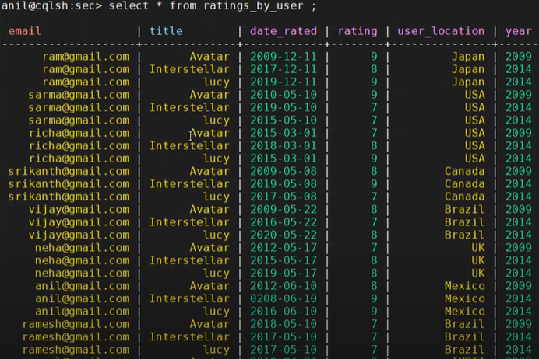
Query-2

Slide 63
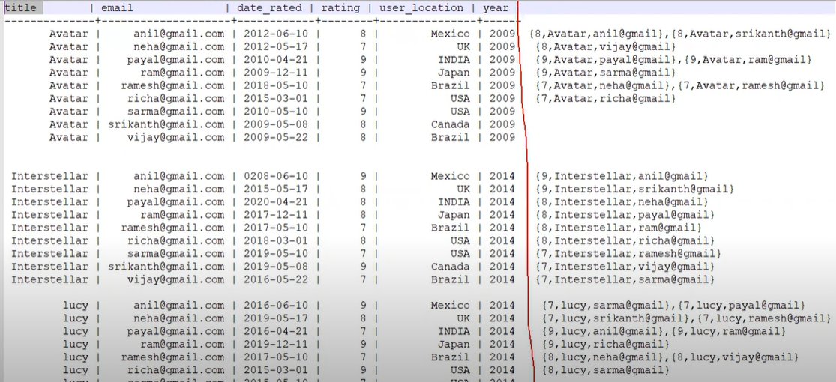
Secondary index
Select * from ratings_by_movies where rating=8;

Slide 64
syntax
Create index IndexName on KeyspaceName.TableName(ColumnName);
CREATE INDEX [ IF NOT EXISTS ] index_name
ON [keyspace_name.]table_name
([ ( KEYS | FULL ) ] column_name)
(ENTRIES column_name);

Slide 65
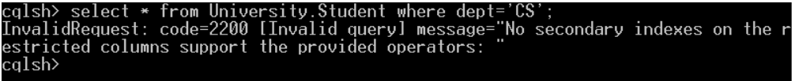
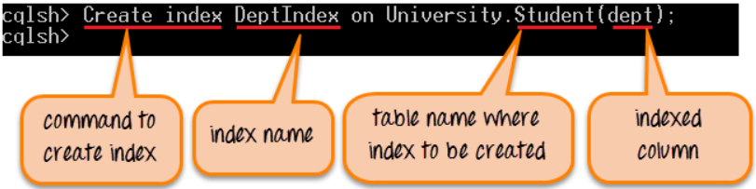
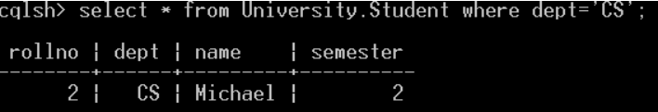
example
Notes:
Secondary index will be created and stores the data in the hidden table so that query will be executed faster.

Slide 66
Drop index
Command ‘Drop index’ drops the specified index.
If the index does not exist, it will return an error unless IF EXISTS is used that will return no-op.
During index creation, you have to specify keyspace name with the index name otherwise index will be dropped from the current keyspace.
Syntax:
Drop index IF EXISTS KeyspaceName.IndexName

Slide 67
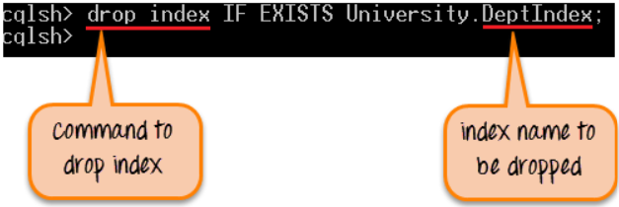
example
After successful execution of the command, DeptIndex will be dropped from the keyspace. Now data cannot be filtered by the column dept.

Slide 68
Using multiple indexes
Indexes can be created on multiple columns and used in queries.
cqlsh> CREATE TABLE cycling.cyclist_alt_stats ( id UUID PRIMARY KEY, lastname text, birthday timestamp, nationality text, weight text, height text );
cqlsh> CREATE INDEX birthday_idx ON cycling.cyclist_alt_stats ( birthday );
CREATE INDEX nationality_idx ON cycling.cyclist_alt_stats ( nationality );
cqlsh> SELECT * FROM cycling.cyclist_alt_stats WHERE birthday = '1982-01-29' AND nationality = 'Russia';

Slide 69
Multiple indexes
The indexes have been created on appropriate low cardinality columns, but the query still fails.
The error is not due to multiple indexes, but the lack of a partition key definition in the query.
When you attempt a potentially expensive query, such as searching a range of rows, Cassandra requires the ALLOW FILTERING directive.
cqlsh> SELECT * FROM cycling.cyclist_alt_stats WHERE birthday = '1990-05-27' AND nationality = 'Portugal' ALLOW FILTERING

Slide 70
Indexing a collection
Collections can be indexed and queried to find a collection containing a particular value.
Set and List collections
CREATE INDEX team_idx ON cycling.cyclist_career_teams ( teams );
SELECT * FROM cycling.cyclist_career_teams WHERE teams CONTAINS 'Nederland bloeit’;

Slide 71
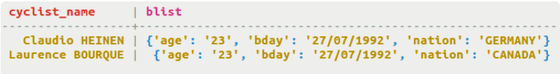
Indexing a collection
Maps
CREATE TABLE cycling.birthday_list (cyclist_name text PRIMARY KEY, blist map<text,text>);
CREATE INDEX blist_idx ON cycling.birthday_list (ENTRIES(blist));
SELECT * FROM cycling.birthday_list WHERE blist['age'] = '23’;

Slide 72
thank you

